Slide 1
Switching techniques

Slide 2
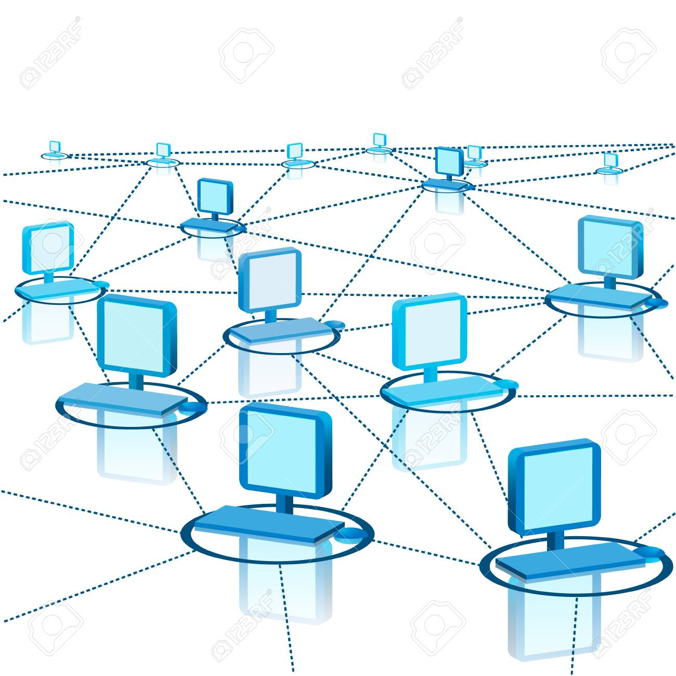
Multiple Paths and Multiple technologies (Wifi, Ethernet etc.) between the same two systems

Slide 3
Switching
It’s the process of transfer of data between two different computers or two different networks.
Types of switching:
Circuit Switching
Message Switching
Packet Switching

Slide 4
Circuit Switching
Circuit switching is a method of communication where a dedicated communication path is established between two devices for the duration of the connection.
Key Features:
Dedicated Path: A continuous, exclusive path is set up for the entire communication session.
Continuous Connection: Once established, the connection remains open and active until the communication session ends.
Efficiency for Voice Applications: Ideal for real-time voice communication like traditional telephone networks due to consistent and predictable data transfer.
Example:
Traditional Telephone Networks: When you make a phone call, a dedicated circuit is established between your phone and the receiver's phone, which remains open until the call ends.

Slide 5
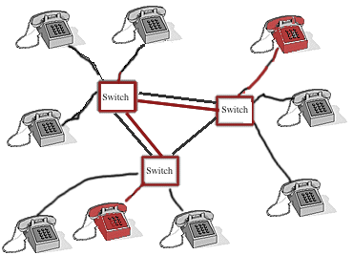

Slide 6
Message switching
Message switching involves the transfer of complete messages from one device to another using a store-and-forward mechanism, without the need for a dedicated path.
Key Features:
No Direct Connection: There is no direct connection between the sender and receiver. Each message is routed independently.
Whole Message Delivery: The entire message is stored at intermediate nodes before being forwarded to the next node.
Suitability for Email: Well-suited for applications where timing is not critical, like email and file transfers.
Example:
Email Transmission: An email message is sent from the sender to an email server, stored temporarily, and then forwarded to the recipient’s email server before being delivered.

Slide 7
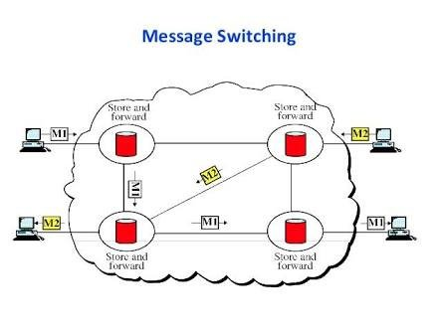

Slide 8
Packet Switching
Packet switching breaks down data into smaller packets that are transmitted independently over the network. Each packet may take a different route to reach the destination.
Key Features:
Dynamic Routing: Packets can take the most efficient route based on network conditions, which can vary during the transmission.
Support for Various Data Types: Suitable for transmitting different types of data (e.g., text, voice, video) efficiently.
Example:
Internet Data Transmission: Web browsing, video streaming, and online gaming rely on packet switching, where data is split into packets that travel across the internet via different routes before being reassembled at the destination.

Slide 9
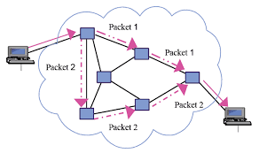

Slide 10
Feature | Circuit Switching | Message Switching | Packet Switching
Connection Type | Dedicated path | No direct connection | No dedicated path, dynamic routing
Data Transmission | Continuous stream | Message by message | Packet by packet, dynamic routing
Efficiency | Efficient for continuous data | Less efficient, higher latency | Highly efficient, especially for bursty traffic
Real-time Capability | Excellent for real-time (e.g., voice calls) | Poor, due to delays and buffering | Good, but depends on network congestion
Use Cases | Voice calls, video conferencing | Email, text messaging | Internet browsing, video streaming, VoIP
Advantages | Reliable, low latency, dedicated resources | Flexibility, no need for a dedicated path | Scalability, flexibility, efficient bandwidth usage
Disadvantages | Inefficient for data, high resource usage | High latency, storage requirements at nodes | Packet loss, variable delays (jitter)

Slide 11
Thank you

